Slide 1
Aws ebs/Snapshots/Autoscaling
ABILASH SR

Slide 2
WHAT IS AWS EBS?
Elastic Block Storage called as EBS
Amazon Elastic Block Store (EBS) is an easy to use,(add/remove)
high-performance, block-​storage service designed for use with Amazon Elastic Compute Cloud (EC2).
Amazon EBS provides a range of options for storage performance and cost.

Slide 3
Types of ebs Volumes
General Purpose (SSD) gp2
General Purpose (SSD) gp3
Provisioned IOPS SSD io1
Provisioned IOPS SSD io2
Cold HDD
Throughput Optimized HDD
Magnetic

Slide 4
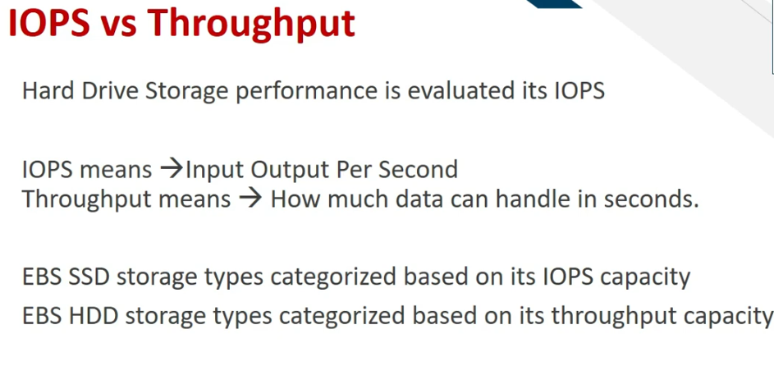

Slide 5
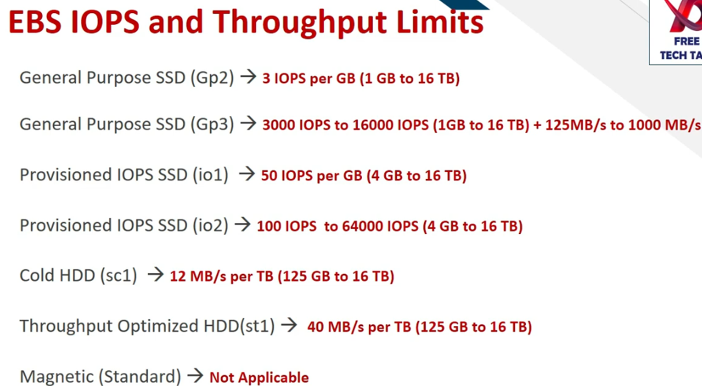

Slide 6
Aws snapshots
EBS Snapshots are an incremental backup
Underlying the EBS is stored in S3
EBS Snapshots are layer by layer taking backup.
1st time Snapshot takes more time after that it takes only lesser time ,Since it only backup the latest data.
The Amazon Data Lifecycle Manager is an automated mechanism that can back up data from EBS volumes, creating and deleting EBS snapshots on a predefined schedule.

Slide 7
AWS Autoscaling
AWS autoscaling is a service that automatically monitor and adjust compute resources to maintain the performance hosted in the AWS
We cannot configure Auto Scaling in cross region
Fleet Management
Scale up -----During high CPU Spikes
Scale down -----During Less CPU Spike

Slide 8
Types Of autoscaling
Horizontal scaling means scaling by adding more machines to your pool of resources.
whereas vertical scaling refers to scaling by adding more power (e.g. CPU, RAM) to an existing machine
States:-
Desired--------- Current State or starting from
MIN--------------Minimum how much machine needed
MAX--------------Maximum how much machine needed

Slide 9
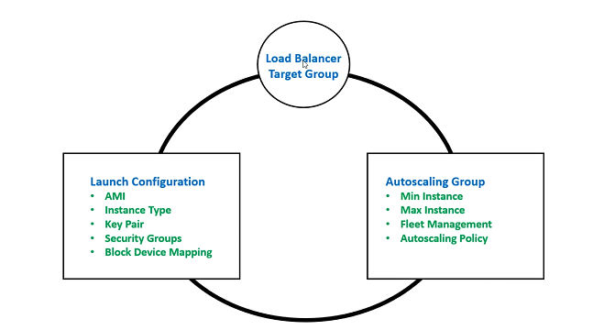

Slide 10
Benifiits
Better Fault Tolerance:- Can detect instance is unhealthy→ terminate → Launch in new instance
Better Availability: Right amount of capacity to handle the current traffic demand
Better Cost Management: Dynamically Increase and decrease capacity as needed
Auto Scaling supports –Apache,IIS,Nginx,Wordpress,Tomcat (Frontend application)
Auto Scaling not supports- Oracle,Mysql,MariaDB,MangoDB (Backend application)

